Slide 1
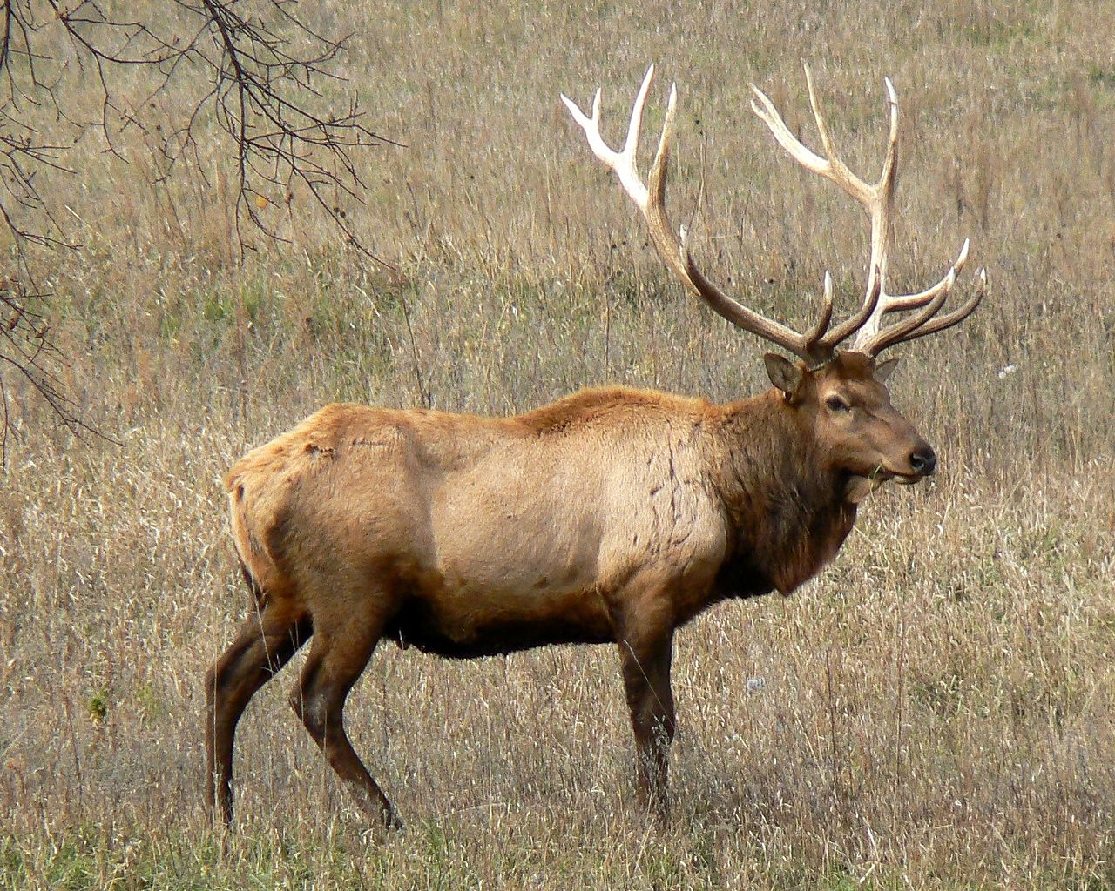
image by Mongo; from Wikipedia

Slide 2
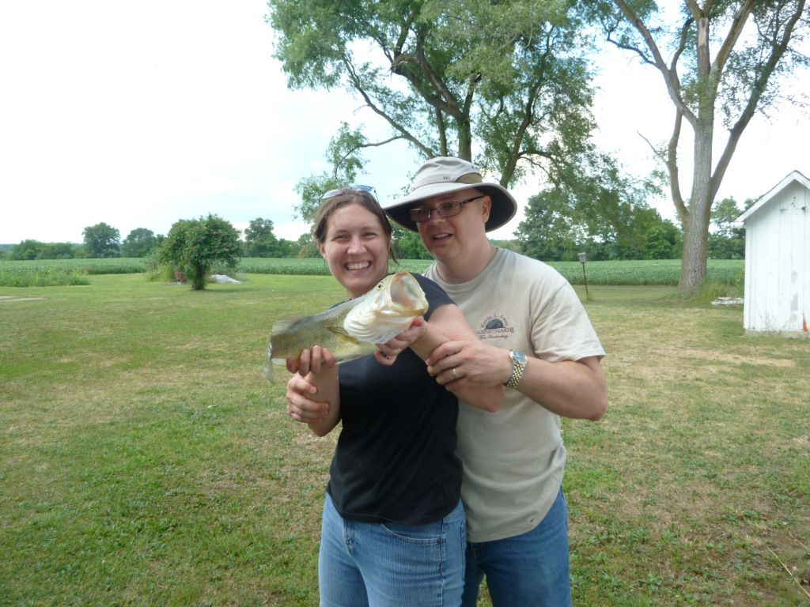
Not my first fish,
but my most recent…

Slide 3
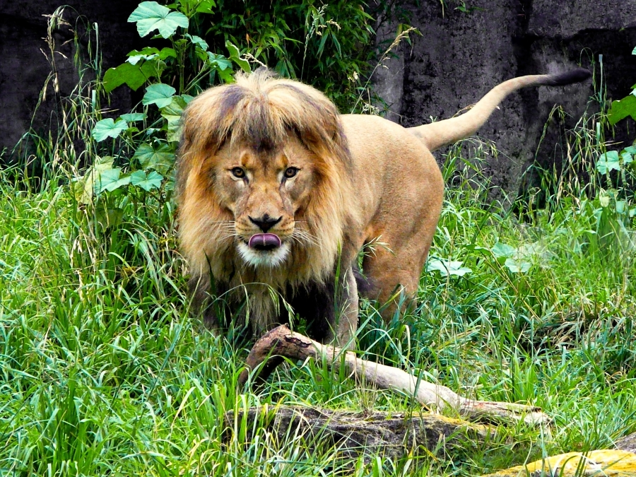
image by Dawn; from everystockphoto.com
1 Peter 5.8 NLT: Stay alert! Watch out for your great enemy, the devil. He prowls around like a roaring lion, looking for someone to devour.

Slide 4
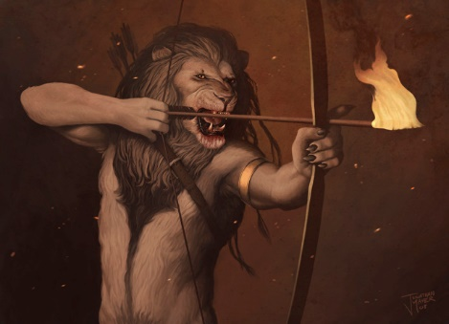
image by Jonathan Mayer; from digital-art-gallery.com
Attacks:
1. Hardship

Slide 5
image by Jonathan Mayer; from digital-art-gallery.com
Attacks:
1. Hardship
2. Temptation

Slide 6
image by Jonathan Mayer; from digital-art-gallery.com
Attacks:
1. Hardship
2. Temptation
3. Deception

Slide 7
James 4.7-8 NLT: “So humble yourselves before God. Resist the devil, and he will flee from you. Come close to God, and God will come close to you.”
1 Peter 5.6-10 NLT: So humble yourselves under the mighty power of God, and at the right time he will lift you up in honor. Give all your worries and cares to God, for he cares about you. Stay alert! Watch out for your great enemy, the devil. He prowls around like a roaring lion, looking for someone to devour. Stand firm against him, and be strong in your faith.

Slide 8
Ephesians 6.10-18 NLT: A final word: Be strong in the Lord and in his mighty power. Put on all of God's armor so that you will be able to stand firm against all strategies of the devil. For we are not fighting against flesh-and-blood enemies, but against evil rulers and authorities of the unseen world, against mighty powers in this dark world, and against evil spirits in the heavenly places. Therefore, put on every piece of God's armor so you will be able to resist the enemy in the time of evil. Then after the battle you will still be standing firm.

Slide 9
… Stand your ground, putting on the belt of truth and the body armor of God's righteousness. For shoes, put on the peace that comes from the Good News so that you will be fully prepared. In addition to all of these, hold up the shield of faith to stop the fiery arrows of the devil. Put on salvation as your helmet, and take the sword of the Spirit, which is the word of God. Pray in the Spirit at all times and on every occasion. Stay alert and be persistent in your prayers for all believers everywhere.

Slide 10
Truth
Righteousness
Peace from the gospel
Faith
Salvation
God’s Word
Persistent prayer
Holy Spirit empowerment
Temptation
[incl. Distraction]
Deception
[incl. Accusation]
Hardships

Slide 11
2 Corinthians 4.4 NLT: “Satan, who is the god of this world, has blinded the minds of those who don't believe. They are unable to see the glorious light of the Good News. They don't understand this message about the glory of Christ, who is the exact likeness of God.”
image from the oak log / quercuscalliprinos.blogspot.com

Slide 12
Ephesians 2.1-6 NLT: Once you were dead because of your disobedience and your many sins. You used to live in sin, just like the rest of the world, obeying the devil-- the commander of the powers in the unseen world. He is the spirit at work in the hearts of those who refuse to obey God. All of us used to live that way, following the passionate desires and inclinations of our sinful nature. By our very nature we were subject to God's anger, just like everyone else. But God is so rich in mercy, and he loved us so much, that even though we were dead because of our sins, he gave us life when he raised Christ from the dead. (It is only by God's grace that you have been saved!) For he raised us from the dead along with Christ and seated us with him in the heavenly realms because we are united with Christ Jesus.

Slide 13
Who are you?
Are you someone who needs to believe in Christ and find forgiveness and help from God?
Are you someone who believes in Christ, but walks a lot in the world, inadvertently following Satan instead of Christ, and thus needs to submit to Christ and experience transformation to be more like him?
Are you someone who is mature in faith, walking in the light, but desperate for ongoing empowerment to stand firm for Christ against evil?

